Slide 1
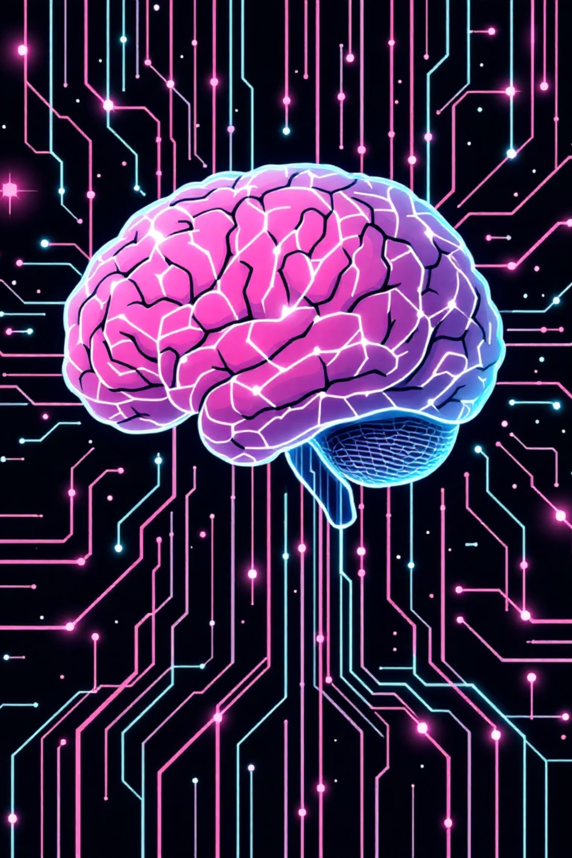
AI-Powered Digital Twin Cloning for Reel Recommendation Using K-Means Clustering
Presented by : M. Karthikeya (Team Leader) P. Sameera
G. Deva
G. Ramya Sri
A. Rajesh
K. Tanuja Sri
BCA – Final Year | Mobile Application Development & Machine Learning

Slide 2

PROBLEM STATEMENT
The Personalization Challenge
Current Limitations
Modern short-video platforms like Reels, TikTok, and YouTube Shorts struggle with true personalization. Most systems rely on simple interest matching and basic category filters, failing to capture the nuances of user behavior.
Shallow behavior understanding
Poor new user experience
Ignores scroll patterns and watch time
Repetitive, irrelevant recommendations
Our Goal: Build a system that analyzes complete user behavior, creates a digital behavioral twin, and uses K-Means clustering to deliver accurate, personalized reel recommendations.

Slide 3
Why This Matters
User Fatigue
Lost Engagement
Behavioral AI Future
Competitive Edge
Repetitive recommendations drive users away from platforms, causing content fatigue and decreased satisfaction.
Irrelevant content equals reduced watch time, which directly impacts platform revenue and growth.
Industry leaders like Meta, Netflix, and TikTok use behavioral twins, not simple interest tagging.
Our model increases watch time, user satisfaction, retention rates, and overall platform engagement.

Slide 4


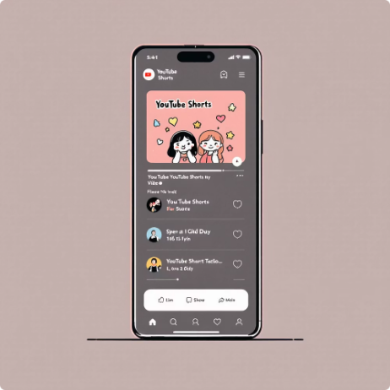
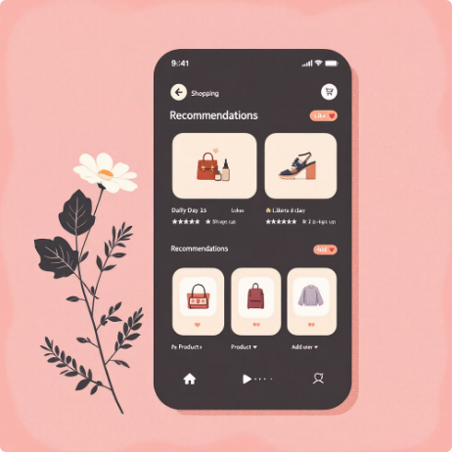
Real-World Applications
Industries Benefiting
Social Media AI
Marketing & Personalization
Video Streaming Platforms
E-commerce Systems
Instagram Reels
TikTok For You
Real Impact
Personalized content discovery
Behavioral recommendation engine
Better retention, increased engagement, higher revenue, and personalized experiences at scale.
YouTube Shorts
E-Commerce
Enhanced user retention
Product recommendation systems

Slide 5
PROJECT GOALS
Our Objectives
01
02
03
Primary Objective
Capture Behavior
Generate Digital Twin
Build a behavioral recommendation engine using Digital Twin Cloning combined with K-Means Clustering for accurate personalization.
Collect and analyze real-time user watch behavior including patterns, preferences, and interaction metrics.
Create an AI behavioral clone for each user that represents their unique viewing patterns and preferences.
04
05
Cluster Users
Deliver Recommendations
Apply K-Means algorithm to group users based on behavioral similarities for targeted recommendations.
Recommend reels from the same behavioral cluster with high accuracy and seamless user experience.

Slide 6
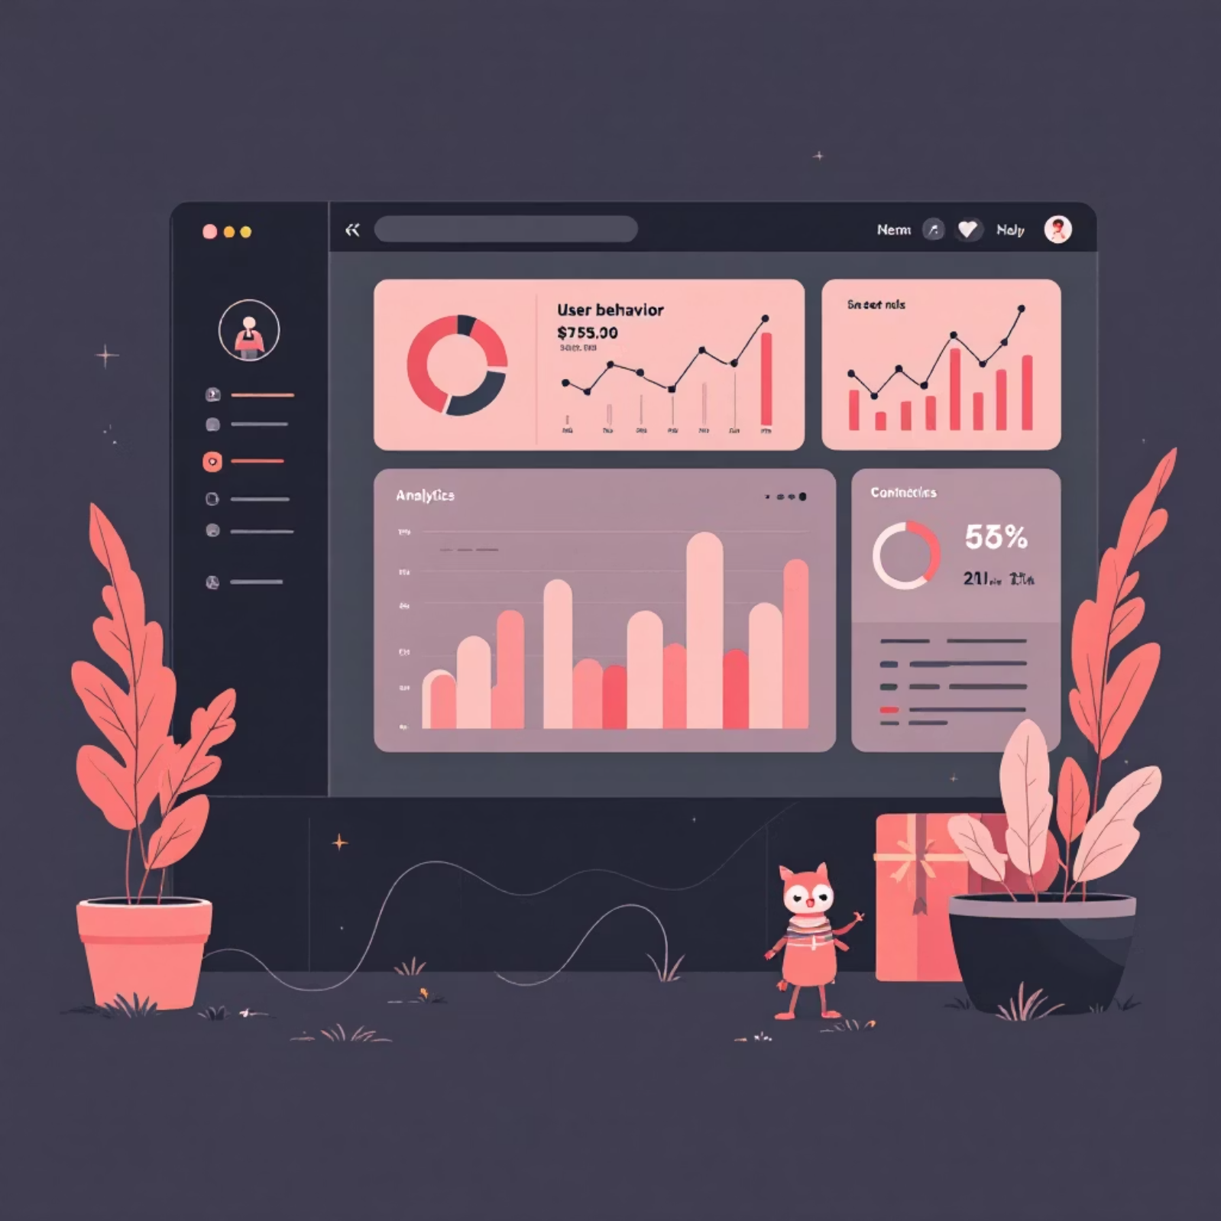
Dataset Architecture
Custom Behavioral Dataset
We created a comprehensive dataset simulating real-world Reels platforms, capturing multi-dimensional user behavior.
Behavior Features
Reel Features
Watch time, completion %, scroll speed, replay count, save count, category interest, hashtag interest, session duration, peak active time, skip ratio
Video ID, category tags, hashtag collections, engagement metrics, popularity scores
User Profile
User ID, preference history, time pattern analysis, behavioral vectors

Slide 7





TECHNOLOGY STACK
Tools & Technologies
Machine Learning
Backend Infrastructure
Python, Pandas, NumPy, Scikit-Learn (K-Means), Matplotlib, Seaborn for data processing and clustering algorithms.
Node.js, Flask, or FastAPI for API development. MongoDB and MySQL for data storage and management.
Frontend Development
Visualization Tools
React.js for building responsive user interfaces and seamless reel browsing experiences.
Canva for design, Chart.js for interactive data visualization, and PowerPoint for presentation materials.

Slide 8
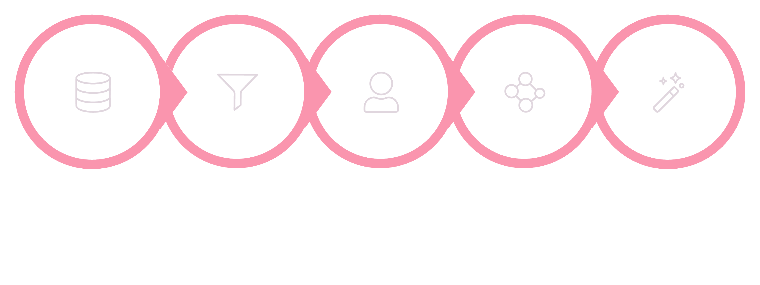





System Methodology
Recommendation
Data Collection
Preprocessing
Digital Twin
K‑Means
Our systematic approach transforms raw behavioral data into intelligent recommendations through a multi-stage pipeline that creates digital twins and applies machine learning clustering for personalized content delivery.

Slide 9
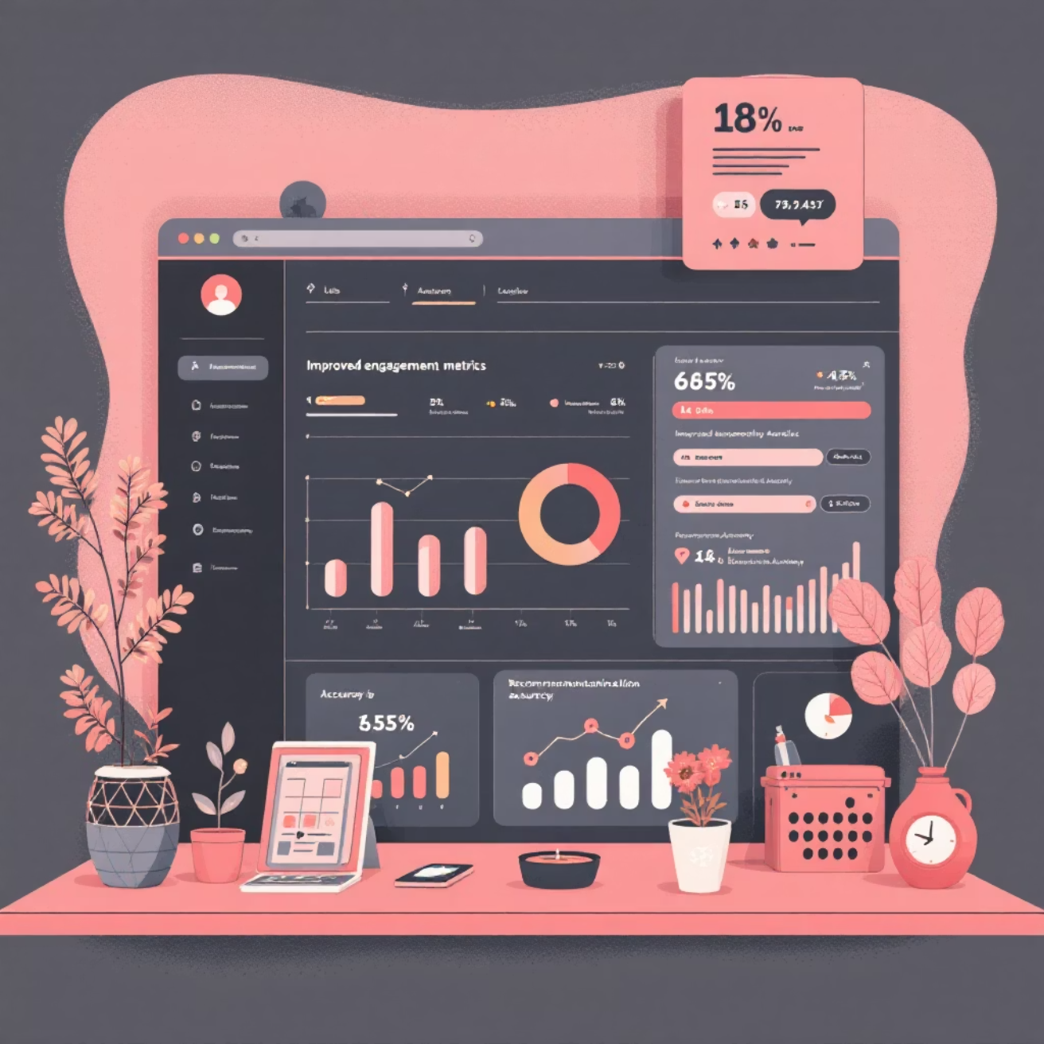
Results & Performance
Behavioral Clusters Identified
1
Fast Scrollers
Quick browsing patterns
2
Tech/Education Lovers
Learning-focused content
3
Comedy Entertainment
Humor and light content
4
Emotional Story Watchers
Narrative-driven videos
5
Late-Night Bingers
Extended viewing sessions
Improved Metrics
More relevant reel recommendations
Faster content discovery
Higher save and replay rates
Increased user engagement
Better watch time retention

Slide 10

Thank You
Project Success
Key Achievement
Future Scope
Successfully built AI-based recommendation system using Digital Twin Cloning + K-Means Clustering
Deep learning models, audio emotion analysis, real-time adaptive clustering, and expanded deployment
Created meaningful behavioral clusters that mimic real Instagram/TikTok recommendation systems
Any Questions?

